Slide 1
Implementation, recruitment, and retention for an Emergency Department-initiated buprenorphine intervention for opioid use disorder
Elias Klemperer, PhD, Miles Lamberson, BA, Roz Bidad, MSN, RN, Amy Dubuque, BSN, RN, Christine Morgan, Ramsey Herrington, MD, Bethany Mahler, LCMHC, LADC, Peter Jackson, MD, Sanchit Maruti, MD, Daniel Wolfson, MD, Michael Goedde, MD, Kyle Dewitt, PharmD, Richard Rawson, PhD, & Scott Mackey, PhD
Departments of Psychiatry and Surgery, Division of Emergency Medicine, University of Vermont Larner College of Medicine

Slide 2
Funding
University of Vermont Health Network Innovation Pilot Grant, SAMHSA 1H79TI081515-01, NIGMS 2P20GM103644-06, NIGMS 5U54GM115516-02, and NIDA 1R21DA049859-01

Slide 3
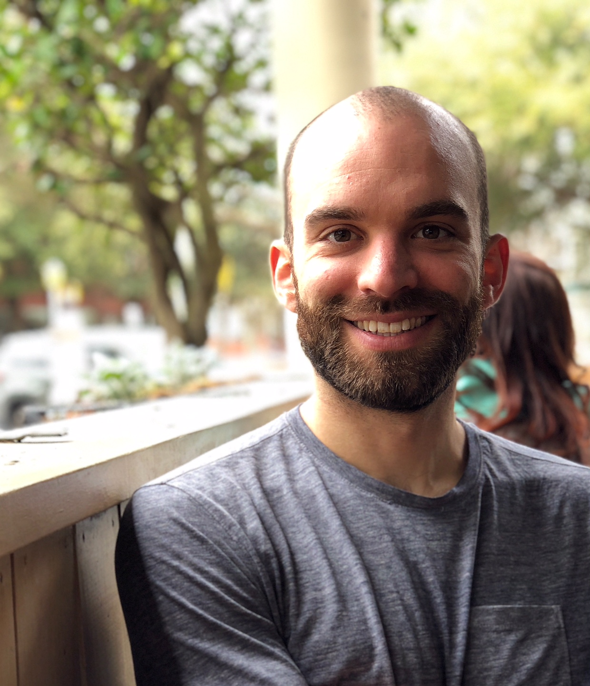
Background
Elias Klemperer, PhD
Opioid use in the US has reached epidemic proportions: 2.1 million people (NSDUH 2017)
⬇ life expectancy (Dowell et al., 2017)
⬆ disease, legal, social problems (SAMHSA, 2018)
⬆ economic burden: $78.5 billion/year (Florence et al., 2016)

Slide 4
Background
Medications for opioid use disorder (MOUD) are effective (Schuckit, 2016)
Buprenorphine (Cochrane review: Mattick et al., 2014)
Methadone (Cochrane review: Mattick et al., 2009)
Naltrexone (Cochrane review: Minozzi et al., 2011)

Slide 5
Background
Most with opioid use disorder (OUD) never access treatment (Wu et al., 2016; SAMHSA 2018)
Common barriers (Sharma et al., 2017)
Financial
Regulatory
Geographic
Attitudinal
Logistic

Slide 6
Methodology
Ongoing study of buprenorphine/naloxone initiation in an Emergency Department
Recruitment in the Emergency Department
Participants receive buprenorphine/naloxone “starter pack” & referral to outpatient Tx

Slide 7
Methodology
Data collection
Urine toxicology and baseline surveys in the Emergency Department
3-month & 6-month follow-ups

Slide 8
Recruitment strategies
Miles Lamberson, BA
Screen all that enter Emergency Department for opioid use disorder
Patients may be enrolled, regardless of chief complaint
Limited success with patients post overdose due to leaving against medical advice

Slide 9
Results: Intake
Gender (% female) | 32.8%
Mean (SD) Age | 35.9 (9.6)
Race/Ethnicity
Hispanic | 1.7%
American Indian/Alaska Native | 6.7%
Black | 3.4%
White | 86.6%
Other | 1.6%
Education
< High school | 20.2%
High school or GED | 47.1%
Some college or higher | 37.9%
Unemployed | 55.5%
Median past 30-day income | $828
Median number of past 30-day crimes | 29
Awaiting trial or on probation/parole | 35.2%
Intakes: N=119 as of 6/25/20

Slide 10
Results: Intake
Past 30-day opioid use
Heroin | 56%
Opioids | 39%
Any injection drug use | 38%
Past 30-day other substance use
Alcohol binge (5+drinks) | 22%
Cocaine or Crack | 44%
Marijuana or Hash | 66%
Methamphetamines | 19%
Benzodiazapines | 22%
Median self-reported health status (1=excellent to 5=poor) | 4
Past 30-day mental health
Depression on most days | 37%
Anxiety on most days | 53%
Trouble concentrating | 52%
Ever experienced trauma | 79%

Slide 11
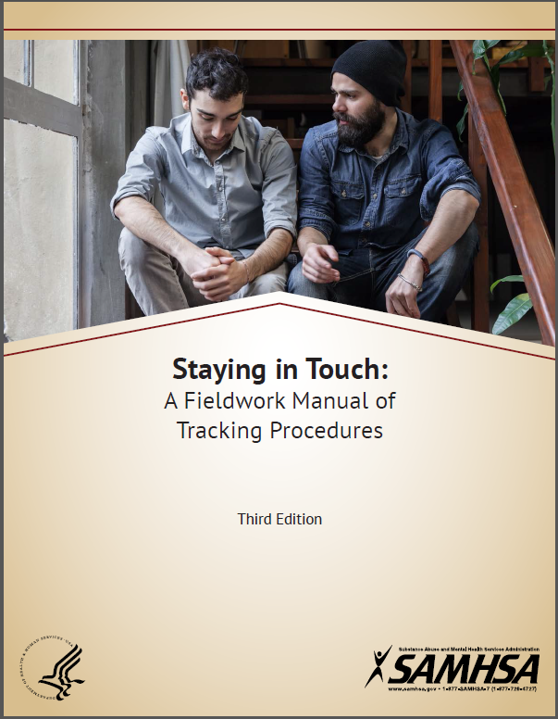
Retention strategies
Roz Bidad, MSN, RN
Telephone
Text messages
Emails
Letters
Family & Friends (with participant’s consent)
Sharon Hall

Slide 12
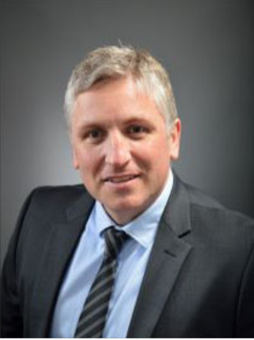
Results: Follow-up
September 1, 2019 to March 13, 2020
Recruited 46 (3 withdrawn, 3 in prison)
Follow-up rates to present:
3 months | 6 months
29/40 (70.0%) | 20/26 (76.9%)
Since March 13, 2020 (COVID-19)
Recruited 3
Follow-up rates to present:
3 months | 6 months
n/a | n/a
Scott Mackey, PhD

Slide 13
Impact of COVID-19
Scott Mackey, PhD
Continued research, provides acute clinical care
However, only 3 new participants
Increased induction from other community providers
National Guard and Army presence could be a deterrent
Difficulty coordinating enrollment & recruiting remotely

Slide 14
Summary
Buprenorphine in an Emergency Department
Participant recruitment
Participant retention

Slide 15
Thank you!
Contact:
Scott Mackey, PhD (Principal Investigator)
Phone: (802) 656-3774
E-mail: msmackey@uvm.edu

